Slide 1
4.2 Types of programming language, translators and integrated development environments (IDEs)
Explain what is meant by a high-level language and a low-level language, including the advantages and disadvantages of each
Understand that assembly language is a form of low-level language that uses mnemonics, and that an assembler is needed to translate an assembly language program into machine code
Describe the operation of a compiler and an interpreter, including how high-level language is translated by each and how errors are reported
Advantages and disadvantages include: ease of reading and writing code, low-level is hard to read ease of debugging code machine independence direct manipulation of hardware
A compiler translates the whole code at once before executing it, producing an executable file
An interpreter translates and executes the code line-by-line
A compiler provides an error report for the whole code if errors are detected
An interpreter stops execution when an error is found
To include an understanding that an interpreter is mostly used when developing a program and a compiler is used to translate the final program
– code editors
– run-time environment
– translators
– error diagnostics
– auto-completion
– auto-correction
– prettyprint
Explain the advantages and disadvantages of a compiler and an interpreter
Explain the role of an IDE in writing program code and the common functions IDEs provide

Slide 2
Note.
If we did this topic in syllabus order (4.1) its such a stupid place to put it, because it will be better done during programming.
So this is PPT will be done during our programming PPTs
But I made it a separate PPT here so its easier for revision

Slide 3
Today
Explain what is meant by a high-level language and a low-level language, including the advantages and disadvantages of each
Understand that assembly language is a form of low-level language that uses mnemonics, and that an assembler is needed to translate an assembly language program into machine code
Describe the operation of a compiler and an interpreter, including how high-level language is translated by each and how errors are reported
Advantages and disadvantages include: ease of reading and writing code, low-level is hard to read ease of debugging code machine independence direct manipulation of hardware
A compiler translates the whole code at once before executing it, producing an executable file
An interpreter translates and executes the code line-by-line
A compiler provides an error report for the whole code if errors are detected
An interpreter stops execution when an error is found
To include an understanding that an interpreter is mostly used when developing a program and a compiler is used to translate the final program
– code editors
– run-time environment
– translators
– error diagnostics
– auto-completion
– auto-correction
– prettyprint
Explain the advantages and disadvantages of a compiler and an interpreter
Explain the role of an IDE in writing program code and the common functions IDEs provide
Understand: Where are HLL and LLL used?
Able: Explain the advantages and disadvantages of HLL and LLL
Answer: What it is the difference between compiler and interpreter

Slide 4
Language
What does this say?
Бұл мен аударуда қолданатын кездейсоқ мәтін
How about this:
这是我用来翻译的一些随机文本
And now?
This is some random text that I'm using to translate
It (should be) the same sentence in Kazakh, Mandarin and English.
But why could you not read the Kazakh?

Slide 5
Language
Can a computer understand:
5
No, it can only understand Binary, so 5 is really 0 1 0 1.
So everything we do needs to converted into Binary
But we don’t say converted, we have to say it gets translated into Binary
There are three types of translators that do the translating
Assembler
Interpreter
Compiler

Slide 6
Assembler
The first type of translator is an Assembler.
An Assembler only translates Assembly Language.
Assembly Language is considered as a Low Level Language

Slide 7
Assembler
So Assembly language is code.
The code is made from two parts
Opcode
Operand
This assembly language code then has to be translated into machine code (binary)
The job of translating assembly language is done by the Assembler.
There are two types of assembler
One Pass Assembler
Two Pass Assembler

Slide 8
One Pass
Okay, this is where Cambridge wants me to explain: “What is a one-pass assembler” but really what they want is about a Load-and-go assembler.
Load-and-go Assembler
You write your assembly code
The assembler looks at each line
Right away it executes each line
+ Fast. Because it does things right away
- Stupid. Because it does not check for errors
- Stupid, no forward referencing

Slide 9
Real one-pass assembler
So if load-and-go is too stupid, then we can use a one pass assembler.
One-pass assembler
Reads all your code one time
As it reads your code it builds two tables. An Opcode Table and a Symbol table
The opcode table just says “oh you typed in 107, it means ADD something”
So ADD is put in the table
We want to add whatever is in memory location 07, so 07 is put in the symbol table
3. When it finishes building the tables, then your code is run
+ Fast, only one pass
+ If there’s any errors it can see
- Cannot handle forward referencing

Slide 10
Interpreter and Compiler
An interpreter is one way to translate a high level language
A compiler is another way to translate a high level language
We code in high level languages. C, C#, C++, Python, Visual Basic, HTML, Java, Java Script are all types of High Level Languages
High Level Language (HLL) = Code written that looks similar to English

Slide 11
Video Questions:
Q1. To get a computer to understand you, what has to be translated?
Q2. How many types of translator are there?
Q3. Name the different translators
Q4. Instead of Gobbldy-Gook, what language does it actually get translated into?
Q5. True or false, the interpreter leaves you.
Q6. Using an interpreter means you cannot correct your mistake. True or False?
Q7. What is the main difference the compiler has over other translator
Q8. True or false, the compiler stays with you
Q9. When using a compiler, the mechanic has to wait for each instruction to be translated one by one. True or false?
Q10. Explain the advantages and disadvantages of the different translators types
Q11. What is one way to remember the way the interpreter works?
Q12. What is one way to remember the way the compiler works?
Q13. What part of a computer is the ‘mechanic’?
Q14. Which translator do you have to use in modern computers?

Slide 12


Slide 13
Video Questions:
Q1. To get a computer to understand you, what has to be translated?
Q2. How many types of translator are there?
Q3. Name the different translators
Q4. Instead of Gobbldy-Gook, what language does it actually get translated into?
Q5. True or false, the interpreter leaves you.
Q6. Using an interpreter means you cannot correct your mistake. True or False?
Q7. What is the main difference the compiler has over other translator
Q8. True or false, the compiler stays with you
Q9. When using a compiler, the mechanic has to wait for each instruction to be translated one by one. True or false?
Q10. Explain the advantages and disadvantages of the different translators types
Q11. What is one way to remember the way the interpreter works?
Q12. What is one way to remember the way the compiler works?
Q13. What part of a computer is the ‘mechanic’?
Q14. Which translator do you have to use in modern computers?

Slide 14
Extra info - Interpreter
Interpreter:
Translates line by line
Quick to start
If it finds an error it stops right away
Not portable. Your code and the interpreter must be together

Slide 15
Extra info - Compiler
Reads all your code first
Translates everything in one time
Slow to start
If there’s an error, too bad.
Portable. When the translation is done, you can take your program to another computer and use it.
.exe files have been compiled.

Slide 16
Why Cambridge….Why?
Okay, these next bits are in your syllabus and, for a change, it is useful to know these things….. But they are only in your syllabus to make your course a little harder.

Slide 17
Compiler and Interpreter
Compiler = All at once
Interpreter = Line by line
So, does it mean when you are making your program you can use a compiler or an interpreter or can you use both??
It depends on the High Level Language you use.
Most use compilers.
But there is one language that uses both. (Actually, it doesn’t really use both on the same code…..but you’ll see)
That language is JAVA

Slide 18
What about your program?
So do you get to choose if you use a compiler or interpreter?
Well, its all part of your IDE
IDE = Integrated Development Environment
It’s a stupid name, but it is useful.

Slide 19
IDE
Let’s say you want to make a program for your laptop
You need:
Software you can type your code into (text editor)
Compiler or interpreter
Automation tools. To help you code quicker
Debugger. To check for errors
So now you need at least 4 things to make one program.
An IDE is one big program that has all of these features built in, so you don’t have to switch programs, everything is in one place.
Example video:

Slide 20
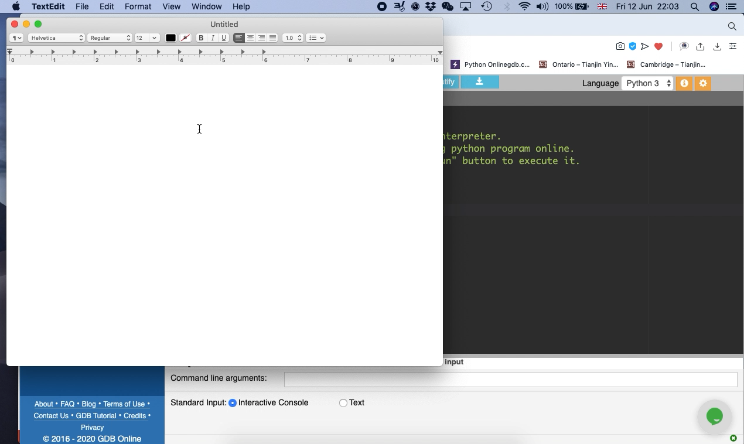

Slide 21
Some more features of an IDE
Context – Sensitive Prompt
When something comes up on screen based on what you are doing.
Example, that menu came up when I was typing in “print”
Initial Error Detection
Your IDE will check for errors when you ask for it
Dynamic Syntax Checks
Your IDE checks for syntax (grammar) errors as you type. So, if you wanted to PRINT but you wrote PNT instead, it will show this as an error as you are typing.

Slide 22
IDE Features
PrettyPrint
When you use indents (spaces) to make your code look more beautiful
Expand and Collapse Blocks
When you can show or hide pieces of code

Slide 23
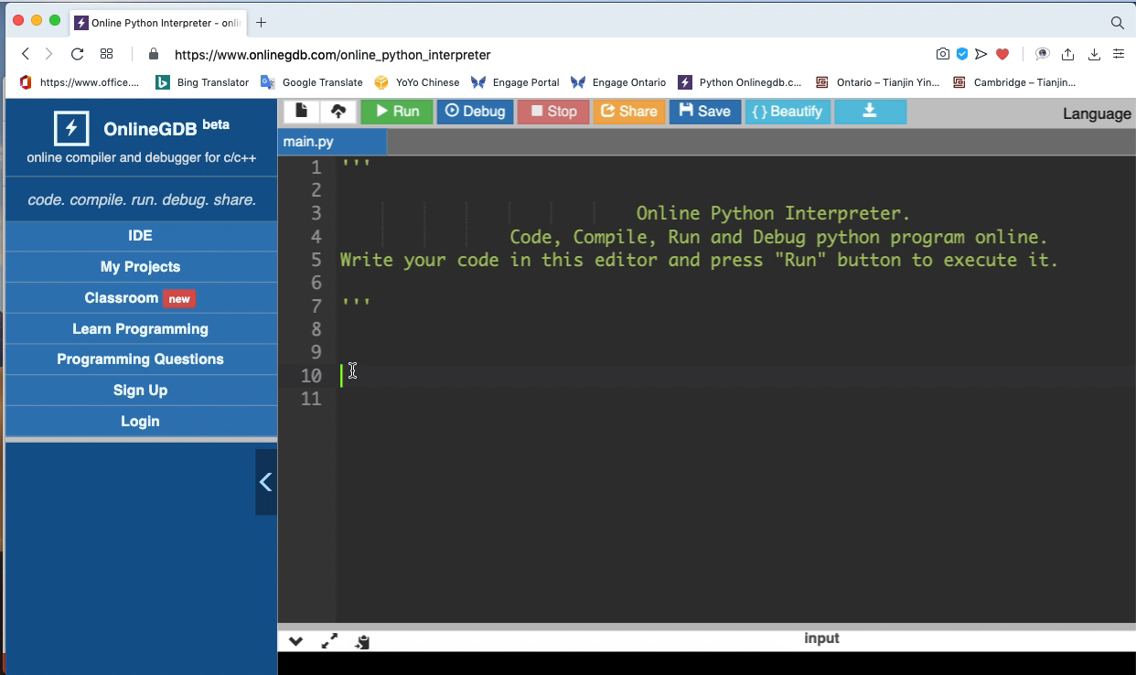

Slide 24
IDE Debugging
As part of your IDE, there is a debugger.
A debugger looks at your code and checks it for mistakes.
Do not confuse with compiler or interpreter which translates your code
Its just that a debugger will usually run first then your compiler or interpreter will translate if your code is perfect.

Slide 25
Types of debugging:
Single Stepping:
Each block of your code is checked one by one.
Breakpoint
You put special code into your code that tells the debugger “when you get to this point, stop and open the debugging / report window”
Debugging window / report window
Its where the debugger shows you where the mistake is.

Slide 26
More IDE Features
Auto Completion
Once you start to type a variable name that you already defined, the IDE will guess what you want and auto complete
Auto Correction
If you make a common mistake, the IDE will auto correct the mistake
Notes:
– code editors
– run-time environment
– translators
– error diagnostics
– auto-completion
– auto-correction
– prettyprint

Slide 27
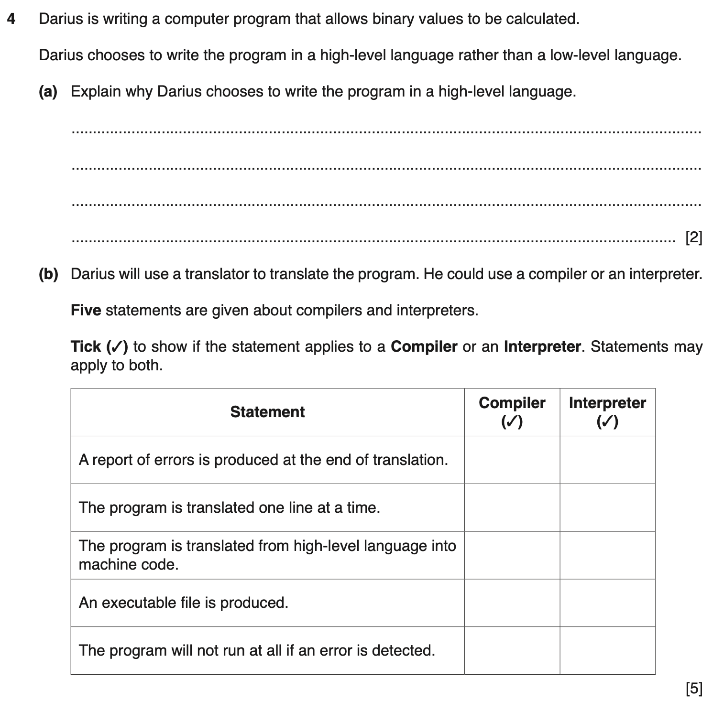
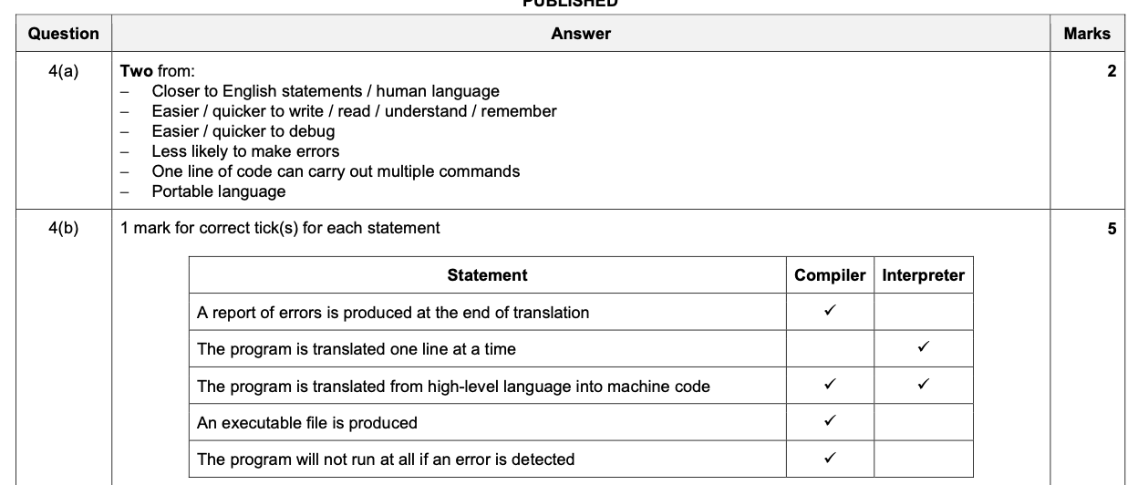

Slide 28
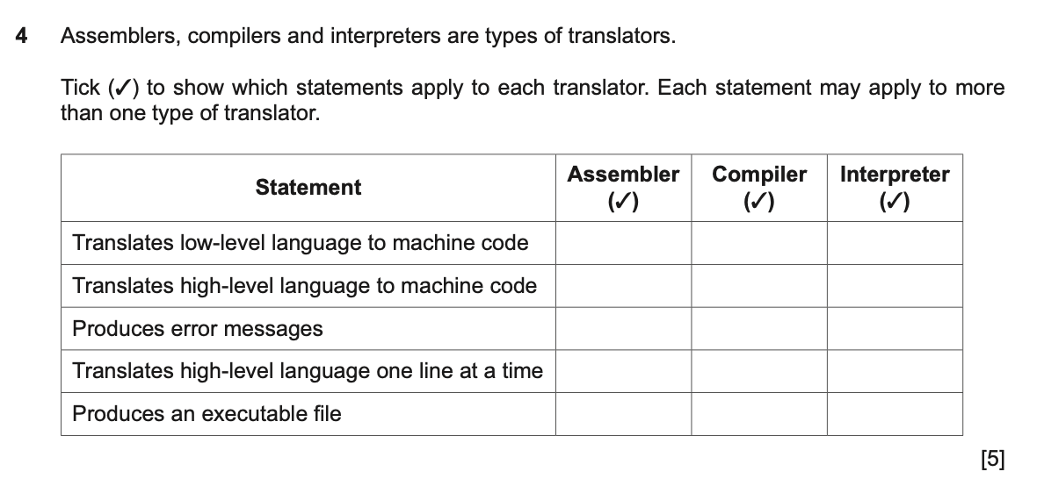
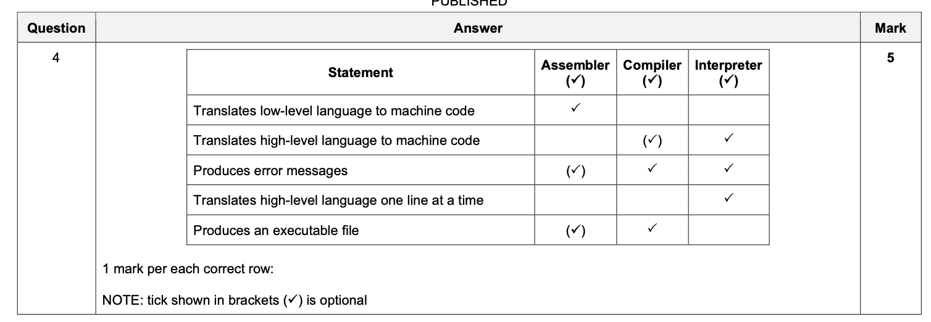

Slide 29
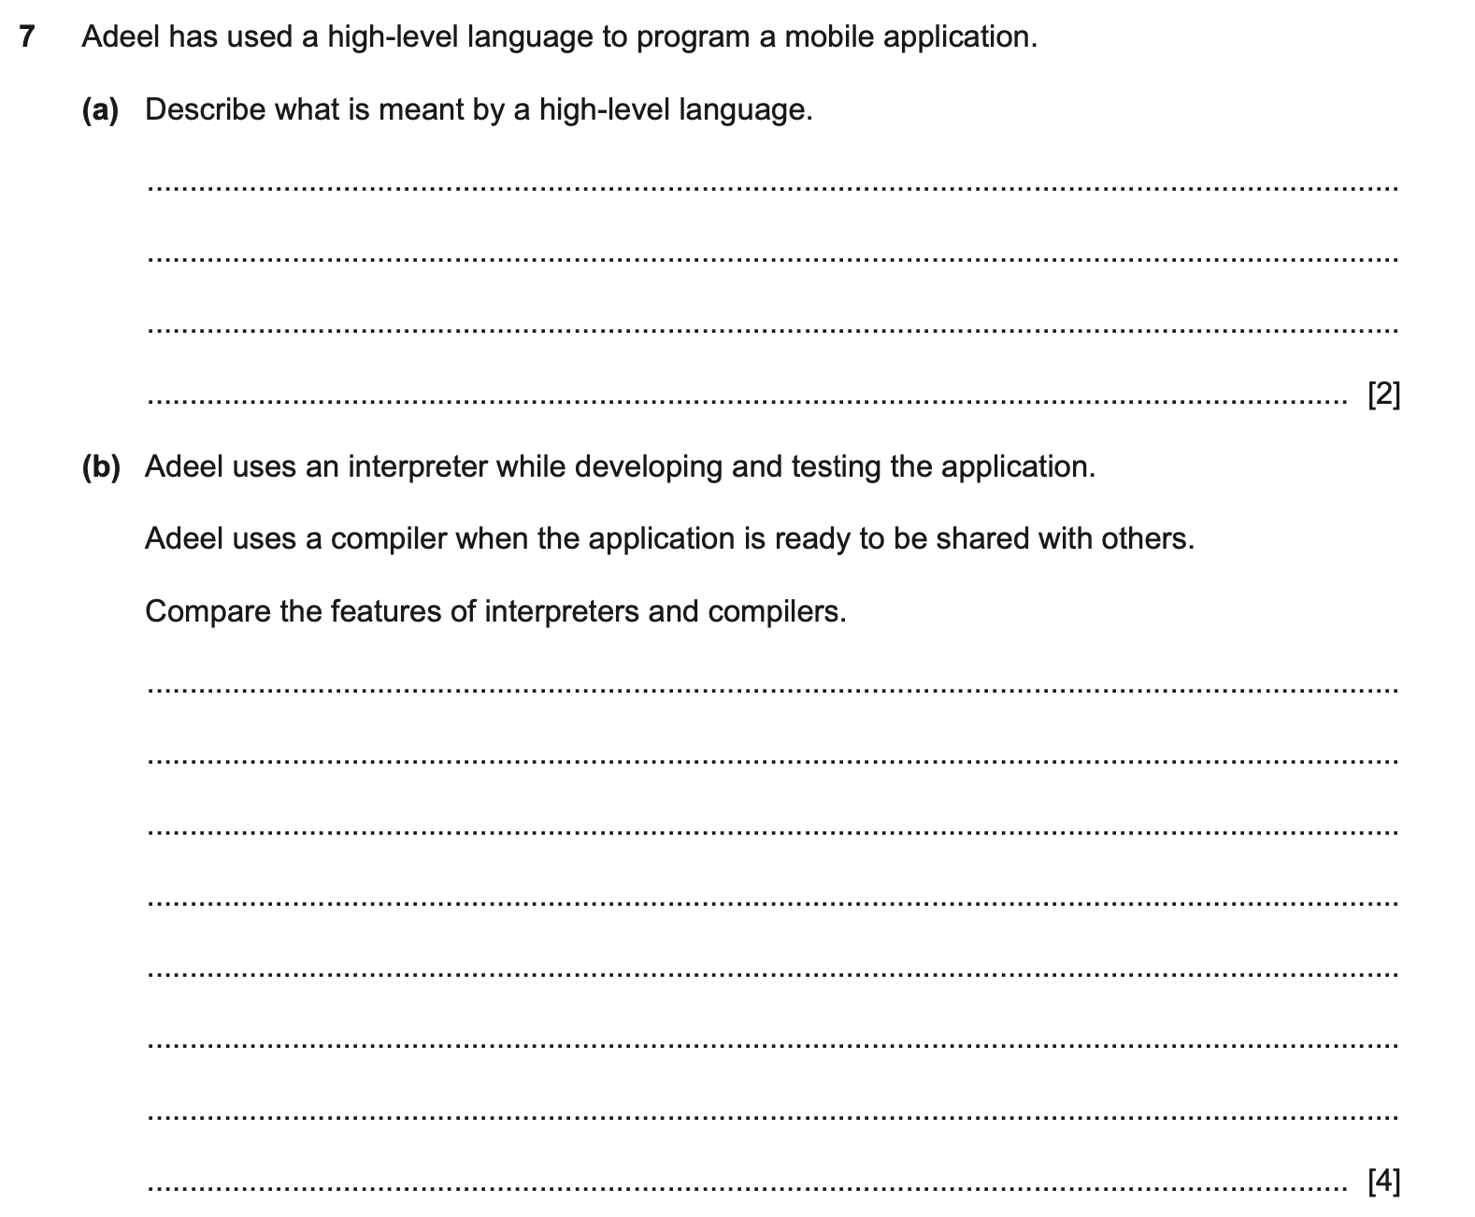
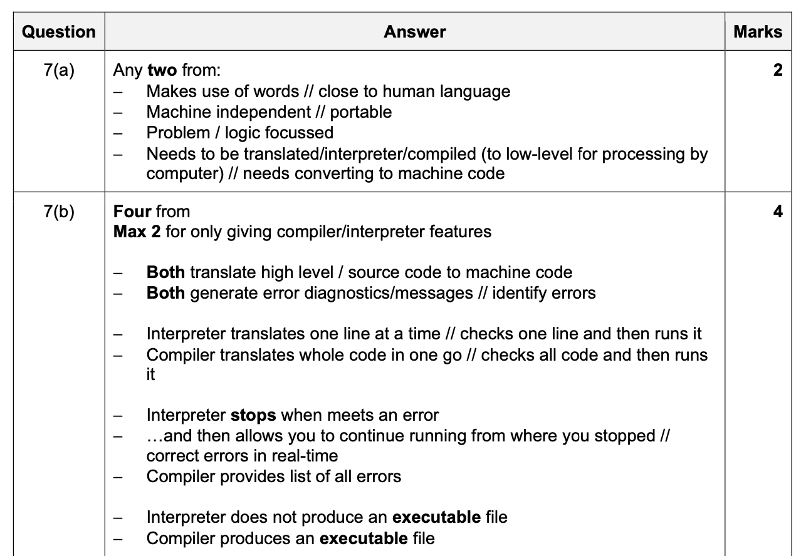

Slide 30
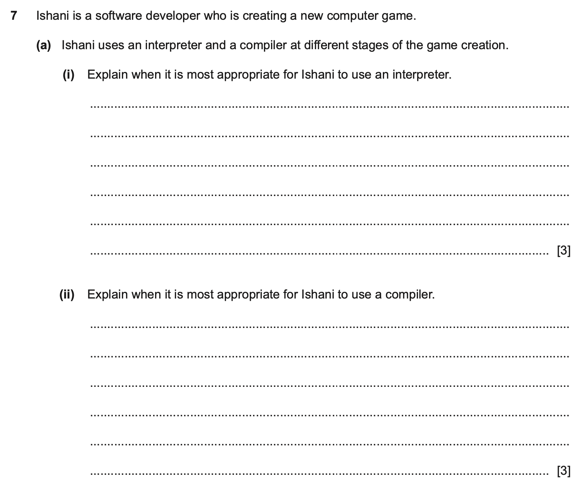
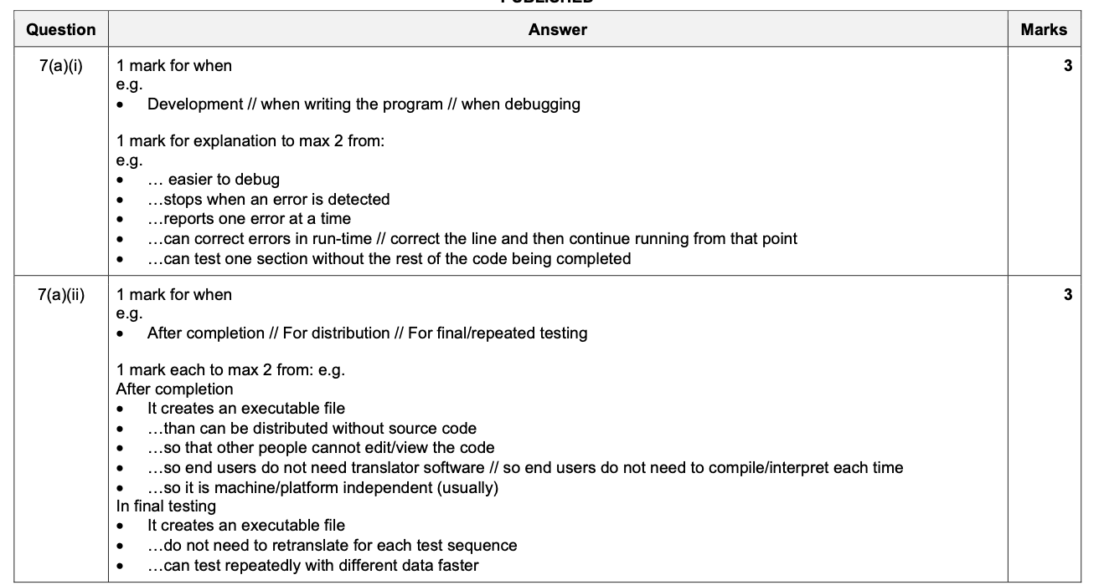

Slide 31
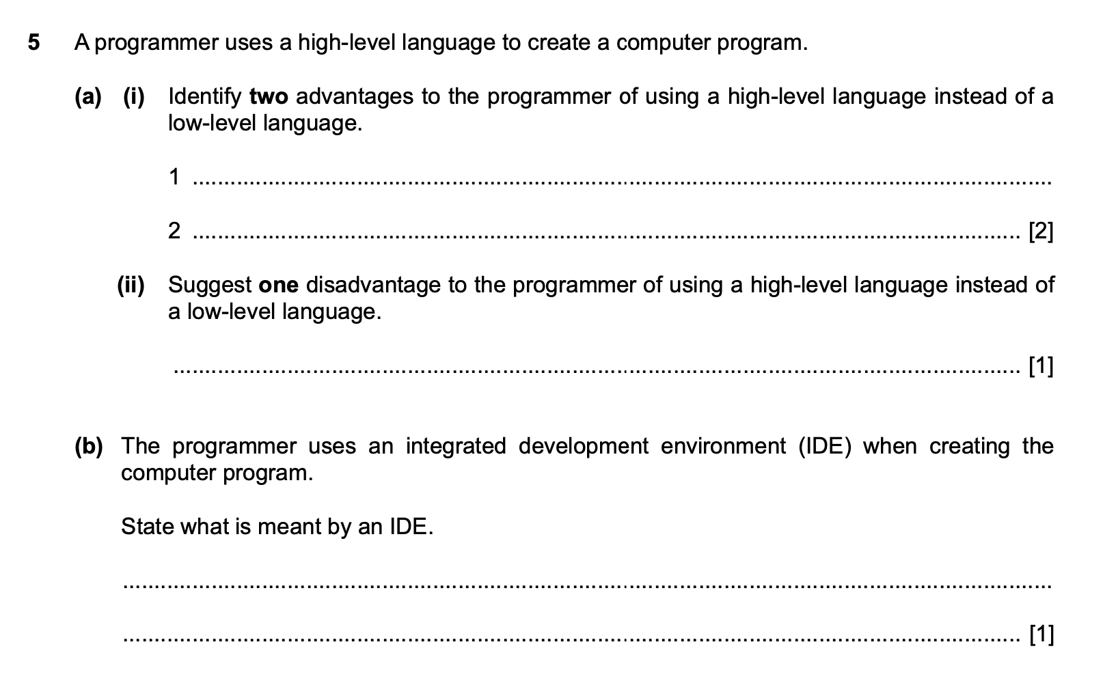
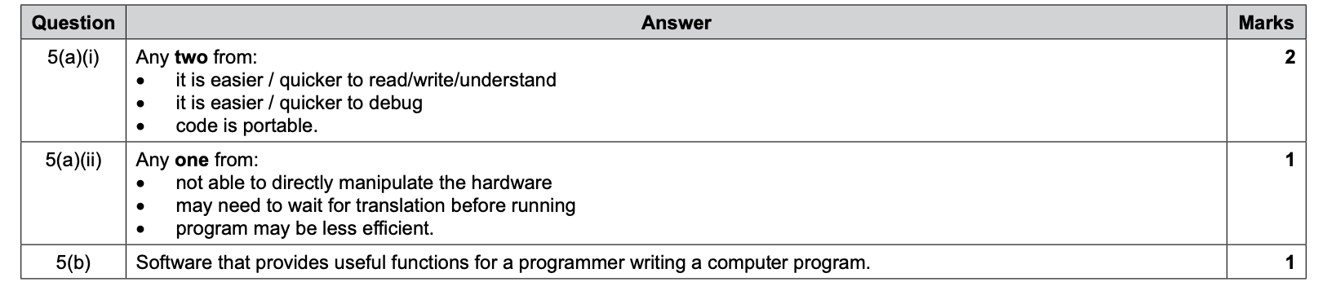

Slide 32
